Slide 1
GENERALIZED ADDITIVE MODELS
Alejandro Ordonez
Assistant Professor - Department of Bioscience
Section for Ecoinformatics & Biodiversity
Center for Biodiversity Dynamics in a Changing World (BIOCHANGE)

Slide 2
mixed effect models What we will talk about today
The basics of smoothing functions – the principle of GAMs
GAMs vs Polynomial regressions – Why go tough all the trouble?.
Introducing GAMs – The backbone and the innerworkings
Expanding GAMs – Beyond the Gaussian model

Slide 3
Any questions?
Ready to start?

Slide 4
Non-parametric smoothers are…
Approximating functions that attempt to capture essential patterns in the data
Focuses on describing the change → Not restricted to a particular model “shape.”
Controlled by “Turing parameters.”

Slide 5
Smoothing important aspects
Smoothing functions have many applications.
Useful for graphically describing a relationship between two variables when we have no specific model in mind.
Plotted Data from Peake & Quinn (1993)

Slide 6
Smoothing important aspects
Smoothing functions have many applications.
Diagnostic method to check the suitability of a linear model or help us decide which form of the nonlinear model might be appropriate.
Plotted Data from Peake & Quinn (1993)

Slide 7
Smoothing important aspects
Smoothing functions have many applications.
Tool for modelling and prediction as part of generalised additive models.
Plotted Data from Peake & Quinn (1993)

Slide 8
Smoothing algorithms menu
Plotted Data from Peake & Quinn (1993) [Week2 - Part 1]

Slide 9
So far so good?
Any questions?
Ready to continue?

Slide 10
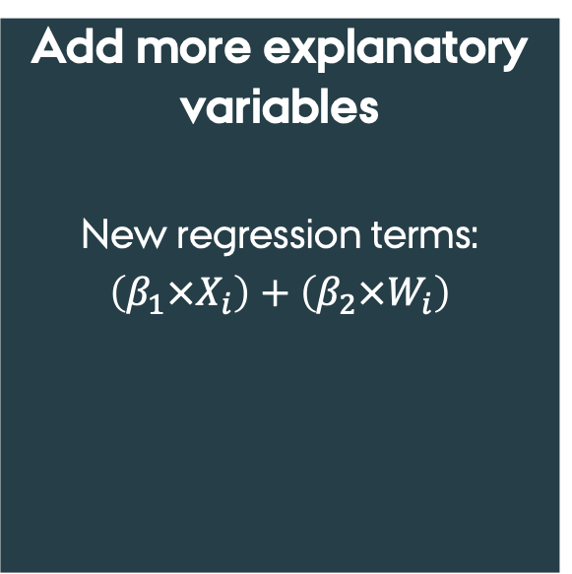
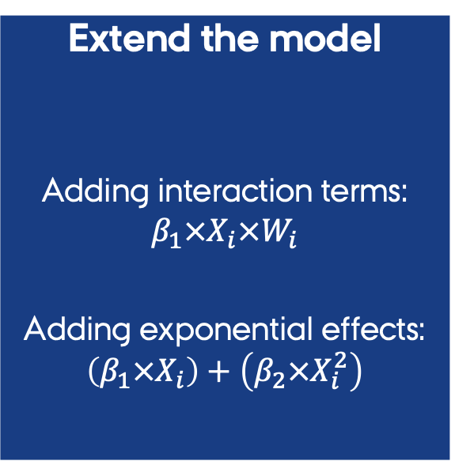
Dealing with non-linearities and complex effects
Extend the model
Adding interaction terms: $β_{1}×X_{i}×W_{i}$
Adding exponential effects: $\left(β_{1}×X_{i}\right)+\left(β_{2}×X_{i}^{2}\right)$
Add more explanatory variables
New regression terms: $\left(β_{1}×X_{i}\right)+\left(β_{2}×W_{i}\right)$
Transform the data
[Log, Powers, roots]
Response variable: Y_{i}
Predictors: X_{i}, W_{i}, Z_{i}

Slide 11
Generalized Additive Models as an alternative
Additive models…
allow for non-linear relationships between the response variable and multiple explanatory variables.
Based on Non-parametric smoothers

Slide 12
Why not Polynomials?
​We can generate similar "smoothing" trends using polynomials.
​
​The issue comes when we want to make predictors, WHY?
Runge's phenomenon → polynomials ca not predict at the edge of the predictor's scale.
Therefore, simply moving to higher-order polynomials doesn't always improve accuracy
6
Polynomial prediction
5
4
Response (y)
3
2
1
Real trend
0
0.0
0.2
0.4
0.6
0.8
1.0
Predictor (x)

Slide 13
So far so good?
Any questions?
Ready to continue?

Slide 14
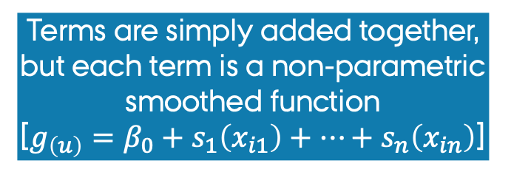
Generalized Additive Models (GAMs)
Terms are simply added together, but each term is a non-parametric smoothed function
[$g_{\left(u\right)}=β_{0}+s_{1}\left(x_{i1}\right)+…+s_{n}\left(x_{in}\right)$]
Can handle many distributions of the response variable
[normal, binomial, counts]
This is a statistical model
Generalized Additive Models

Slide 15
Generalized Additive Models (GAMs)
GAMs are:
Highly flexible non-parametric modifications of GLMM
What do we mean by Non-parametric?
The final fitted model is not constrained to a parametric linear form
Predictors are included in the model as a non-parametric smoothing function → The link to smoothers
This allows non-parametric fits with relaxed assumptions on the actual relationship

Slide 16
Generalized Additive Models (GAMs)
However, GAMs have the same assumptions of a linear models
Error distribution
(standardized) Errors should follow a Normal distribution
Homogeneity of variances
We do not want Heteroscedasticity

Slide 17
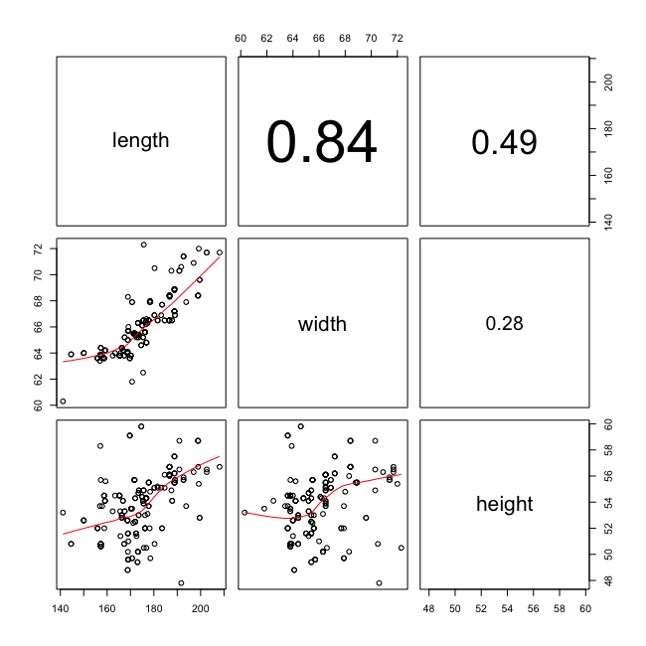
Collinearity and Concurvity
Collinearity
Predictors are correlated/redundant
Problem because:
Outcome variable could be responding to either one

Slide 18
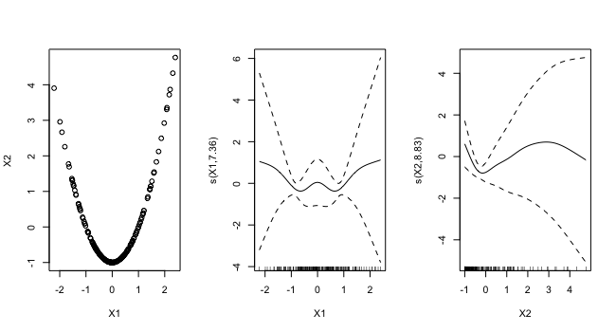
Collinearity and Concurvity
Concurvity
Concurvity, is one predictors can be predicted as a smooth curve of another
Predictor 1
Predictor 2

Slide 19
Collinearity and Concurvity
NO Collinearity
YES Concurvity
Predictor 2
Predictor 1
Predictor 1
Predictor 2

Slide 20
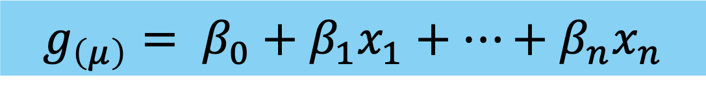
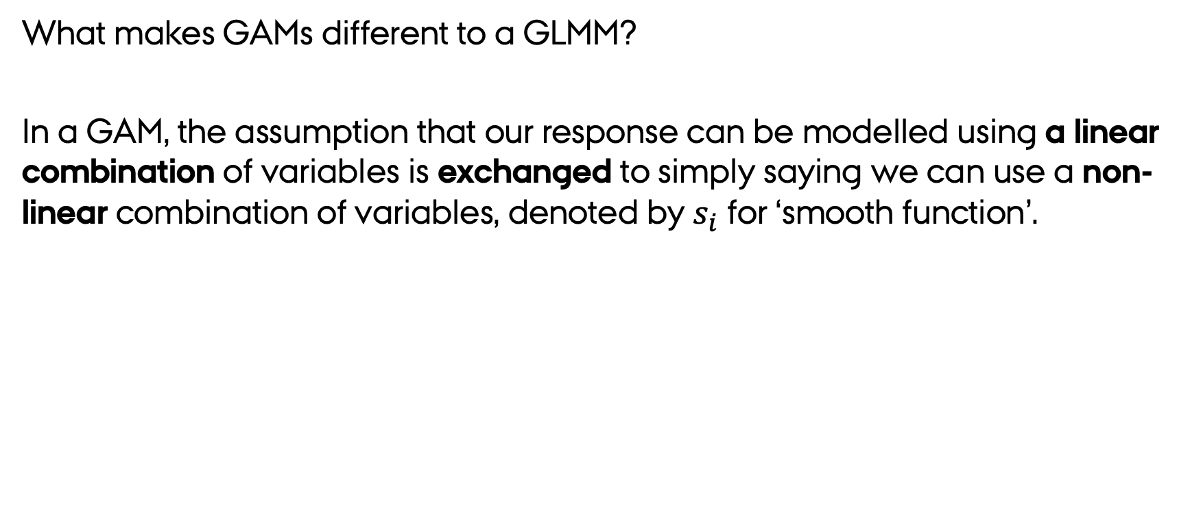

Generalized Additive Models (GAMs)
What makes GAMs different to a GLMM?
In a GAM, the assumption that our response can be modelled using a linear combination of variables is exchanged to simply saying we can use a non-linear combination of variables, denoted by $s_{i}$ for ‘smooth function’.
$$g_{\left(μ\right)}= β_{0}+β_{1}x_{1}+…+β_{n}x_{n}$$
A GLM model
$$g_{\left(μ\right)}=β_{0}+s_{1}\left(x_{1}\right)+…+s_{n}\left(x_{n}\right)$$
A GAM model

Slide 21
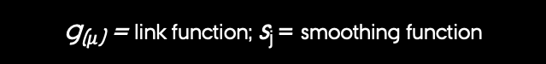
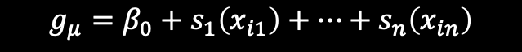
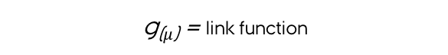
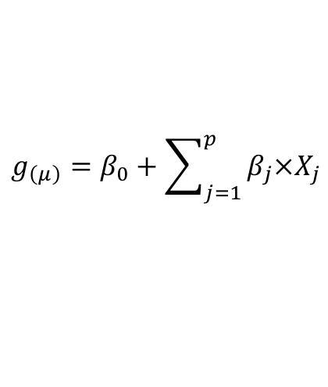
Generalized Additive Models (GAMs)
RAW predictors are not used, but a smoothed version of these → Splines
A key difference between GLMM and a GAM model.
GLMM
We do not use X as a predictor but the result of the smoothed function
$$g_{\left(μ\right)}=β_{0}+\sum_{j=1}^{p}{β_{j}×X_{j}}$$
g₍$μ$₎ = link function
GAM
$$g_{μ}=β_{0}+s_{1}\left(x_{i1}\right)+…+s_{n}\left(x_{in}\right)$$
g₍$μ$₎ = link function; s_{j} = smoothing function

Slide 22
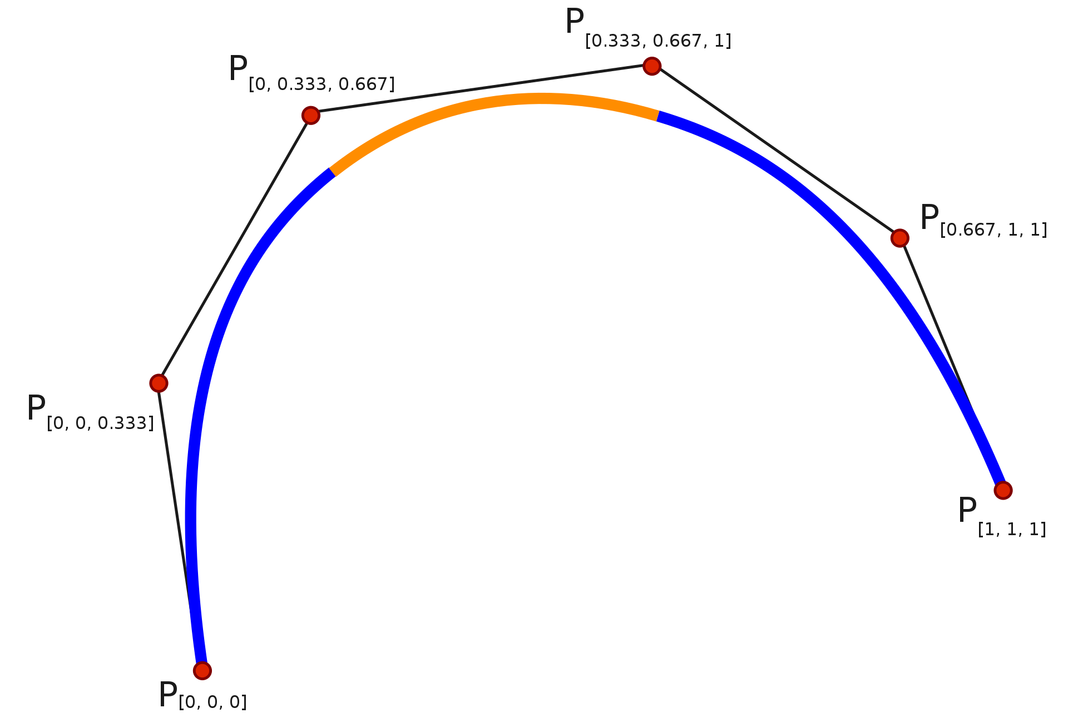
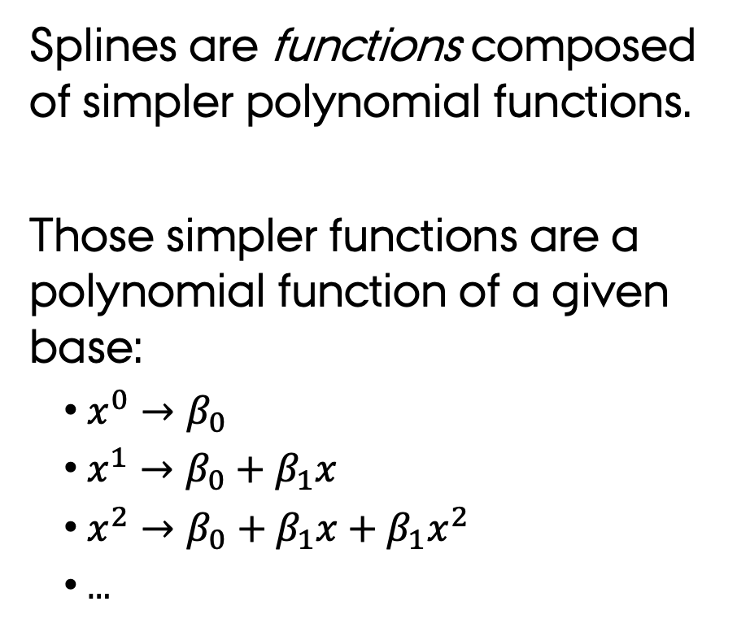
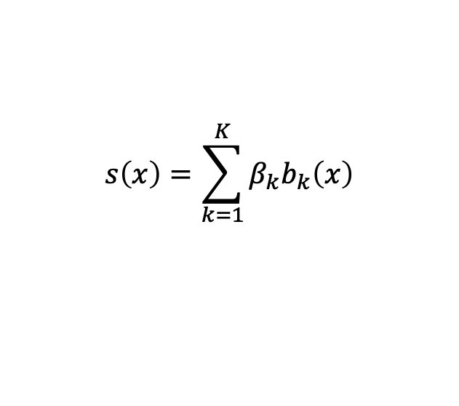
Splines –Smoothing algorithms
Splines are functions composed of simpler polynomial functions.
Those simpler functions are a polynomial function of a given base:
$x^{0}→β_{0}$
$x^{1}→β_{0}+β_{1}x$
$x^{2}→β_{0}+β_{1}x+β_{1}x^{2}$
…
Function 2
Function 3
Function 1
The resultant spline is the sum of these weighted basis functions, evaluated at the values of 𝑥.
$$s\left(x\right)=\sum_{k=1}^{K}{β_{k}b_{k}\left(x\right)}$$

Slide 23
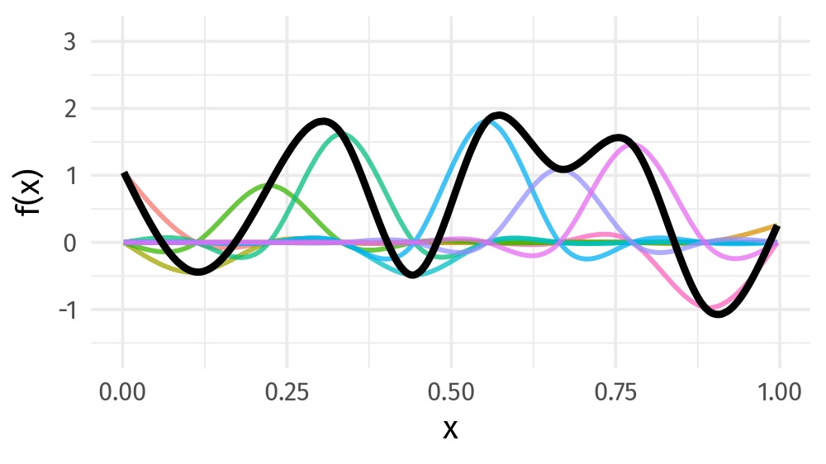
Weight basis functions ⇨ spline
Thanks Gavin Simpson
https://gavinsimpson.github.io

Slide 24
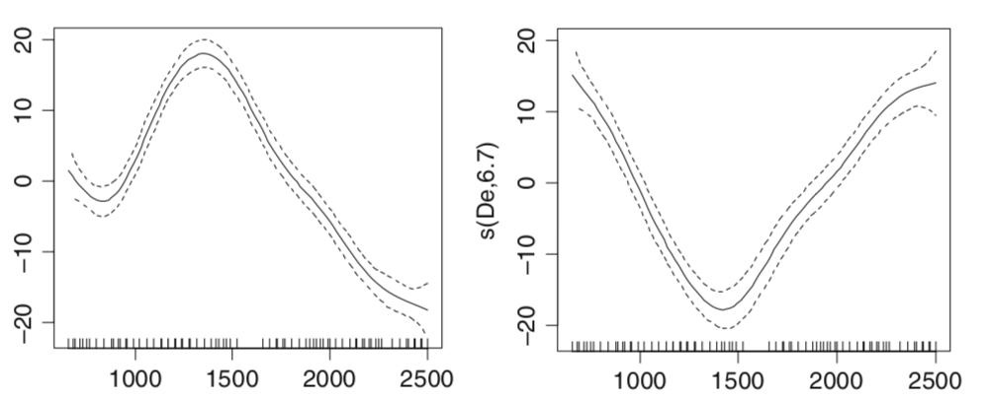
Generalized Additive Models (GAMs)
Each predictor can be “smoothed” differently.
Each predictor smoothing is done separately from the smoothing function for any other predictor.
You can combine smoothed and non-smoothed predictors.
Different parameters
s(Var1,8.07)
lo(Var2,6.7)
Different functions
Var1
Var2

Slide 25
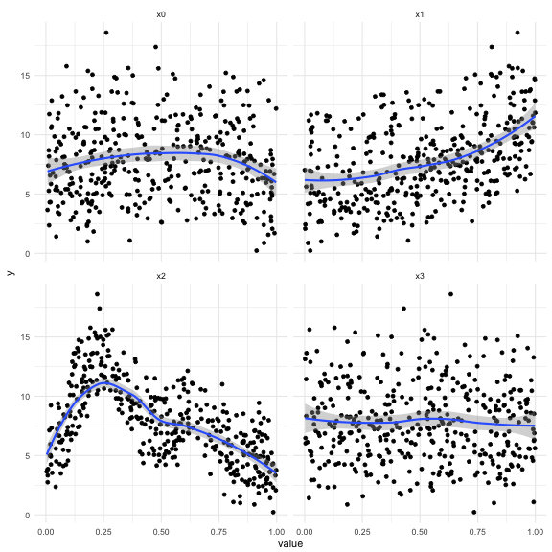
why use smoothing functions?
Want to model the covariates flexibly.
Covariates and response are not necessarily linearly related.
You really want some “wiggles”.

Slide 26
So far so good?
Any questions?
Ready to continue?

Slide 27
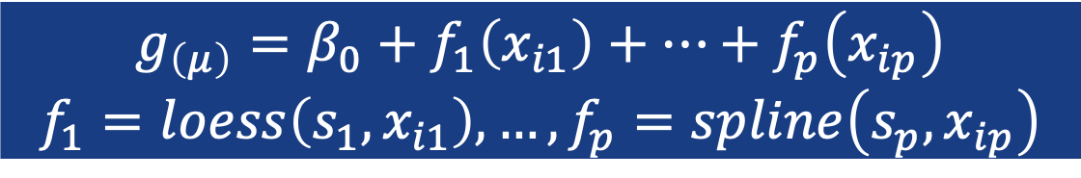
Generalized Additive Models The hard part
The flexibility of GAMs makes them very useful → However, their application is not straightforward.
Difficulty 1: An adequate smoothing function/parameter must be defined for each predictor.
$$g_{\left(μ\right)}=β_{0}+f_{1}\left(x_{i1}\right)+…+f_{p}\left(x_{ip}\right)$$
$$f_{1}=loess\left(s_{1},x_{i1}\right),…,f_{p}=spline\left(s_{p},x_{ip}\right)$$

Slide 28
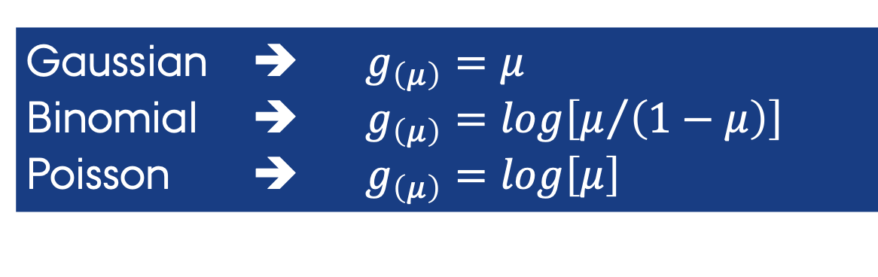
Generalized Additive Models The hard part
Difficulty 2: Which probability distribution and link function combination is appropriate:
Use quasi-likelihood models if there is an over-dispersion problem
quasi-Binomial / quasi-Poisson
Gaussian ➔ $g_{\left(μ\right)}=μ$
Binomial ➔ $g_{\left(μ\right)}=log\left[μ/{\left(1−μ\right)}\right]$
Poisson ➔ $g_{\left(μ\right)}=log\left[μ\right]$

Slide 29
Generalized Additive Models The hard part
Difficulty 3: Appropriate routines for fitting GAMs are not available in most commercial programs, but this is not a problem for us → GAM routines implemented in two R-packages:
mgcv ➔ Mixed GAM Computation Vehicle with automatic smoothness estimation [mgcv::gam]
gam ➔ Generalized Additive Models [gam::gam]

Slide 30
Generalized Additive Models The two packages
mgcv
Estimation of smoothers uses different type of s,splines
Complex implementation
Cubic Regression Splines
Can do cross-validation
optimal amount of smoothing
Allows for generalised additive mixed modelling (GAMM)
gam
Estimation of smoothers uses a back-fitting algorithm
A smoothing function is fitted
The partial residuals are determined and smoothed
Simple implementation
Loess smoothing only
Easy to understand

Slide 31
Generalized Additive Models The two packages
Using gam
Degree of the polynomial repression
-1 = linear
Proportion of the observations in the window
gam(Y.Var ∼ lo(Xvar, degree=-1, span = 0.5))
Using mgcv
gam(Y.Var∼s(Xvar, fx=F, k=-1, bs="cr"))
Spline type
fixed (T) penalized (F)
Proportion of the obs in the window
Spline family
cr=cubic
tp=thin-plate
This default finds the optimal amount of smoothing

Slide 32
So far so good?
Any questions?
Ready to continue?

Slide 33
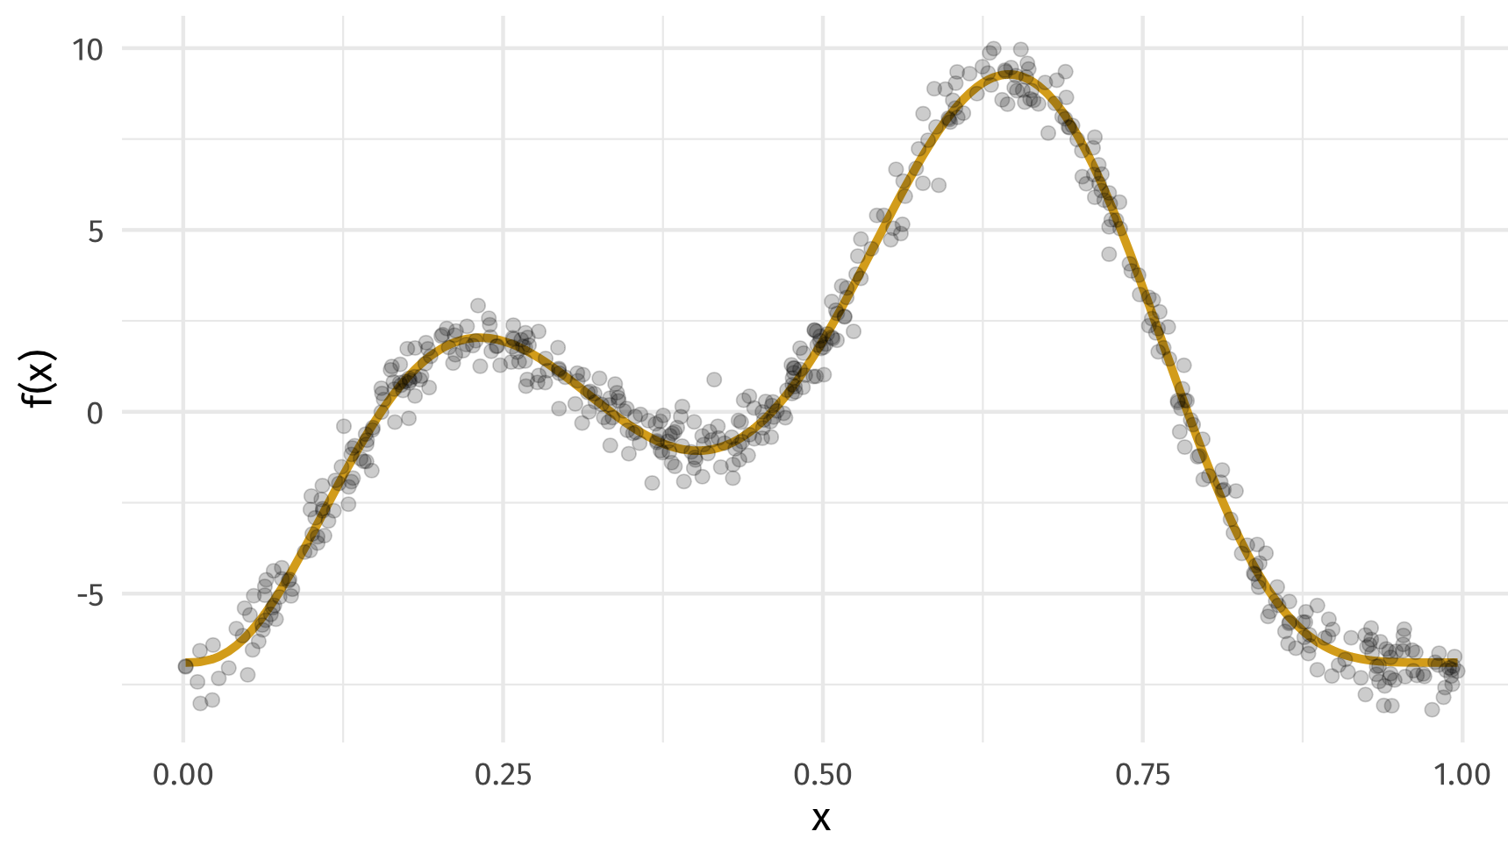
Setting up your splines/smoothers
Observations
The GAM Model
Thanks Gavin Simpson
https://gavinsimpson.github.io

Slide 34
Picking you smoother
There are many types of “smoother” functions you could use
When implanting these in GAMS within R and the mgcv package , you set these using the bs argument
Cubic splines bs = 'cr'
P splines bs = 'ps'
Cyclic splines bs = 'cc'
Adaptive splines bs = 'ad'
Random effect bs = 're'
Factor smooths bs = 'fs’
Duchon splines bs = 'ds'
Spline on the sphere bs = 'sos'
MRFs bs = 'mrf'
Soap-film smooth bs = 'so'
Gaussian process bs = 'gp'

Slide 35
Picking the right wiggliness
In practice, you do this by defining the Maximum allowed wiggliness (k).
i.e., the number of small functions that make the spline.
k must be large enough
the λ penalty does the rest
But large k makes things run slow
K=3
EDF=1.53
The actual wiggliness you spline reflected in the effective degrees of freedom (EDF)
K=10
EDF = 5.79

Slide 36
But hey, isn’t this overfitting?
​So let's check our goal:
Want a line that is "close" to all the data (high likelihood)
We know there is "error", which must be accounted for in the model.
We Don't want splines that just fit every data point.
​​How do we do this without overfitting?
We penalize the process using a smoothing parameter (λ) to define the trade-off between:
Wigglyness à BTW, this is the correct statistical word
Closeness to the data à Likelihood
Large Wigglyness decreases the likelihood

Slide 37
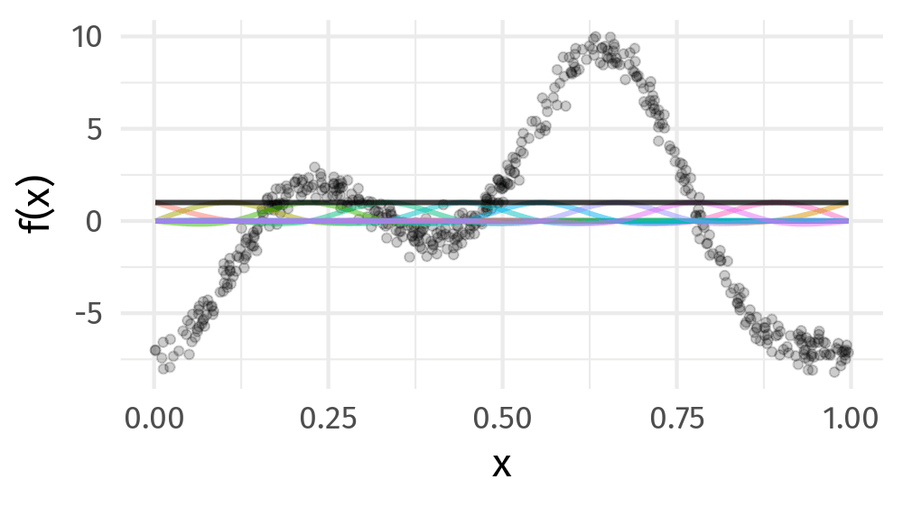
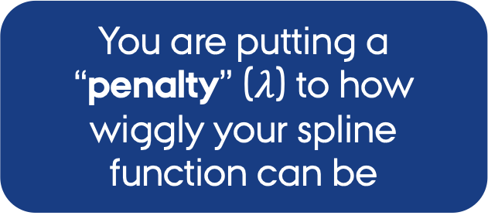
How the “smoothing” is done
Maximise penalised log-likelihood
You are putting a “penalty” ($λ$) to how wiggly your spline function can be
Your smoothing parameter (sp) is how you define this penally in your spline
Thanks Gavin Simpson
https://gavinsimpson.github.io

Slide 38
So far so good?
Any questions?
Ready to continue?

Slide 39

Interactions in GAMS
$$g_{\left(μ\right)}=β_{0}+s_{1}\left(x_{1}\right)+…+s_{n}\left(x_{n}\right)$$
The smoothing effect of one predictor is independent form the smoothing effect of another predictors
What about if X₁ and X₂ have an interacting effect?
You can “smooth” both simultaneously using a Bivariate (or higher order) thin plate splines!
It assumes that the “smoothing” is the same in all directions → Isotropic.
Variables need to be in the SAME SCALE

Slide 40
Interactions in GAMS
$$g_{\left(μ\right)}=β_{0}+s_{1}\left(x_{1}\right)+…+s_{n}\left(x_{n}\right)$$
The smoothing effect of one predictor is independent form the smoothing effect of another predictors
What about if X₁ and X₂ have an interacting effect?
You can use Tensor product smooths
Here, each variable has its own smoothing parameter, but there is an interaction between predictors.
It is anisotropic → “smoothing” is heterogenous between directions
Variables can have in the DIFFERENT SCALES.

Slide 41
So far so good?
Any questions?
Ready to continue?

Slide 42
Model check
Here we need to ask several questions:
Do we have the Right functional form
Did you set the right wiggliness?.
p-values of the smoothed terms.
Check for model assumptions
Homogeneity of variances?
Normality of residuals?
Independence of observations
Observed vs. fitted values
Collinearity & Concurvity

Slide 43
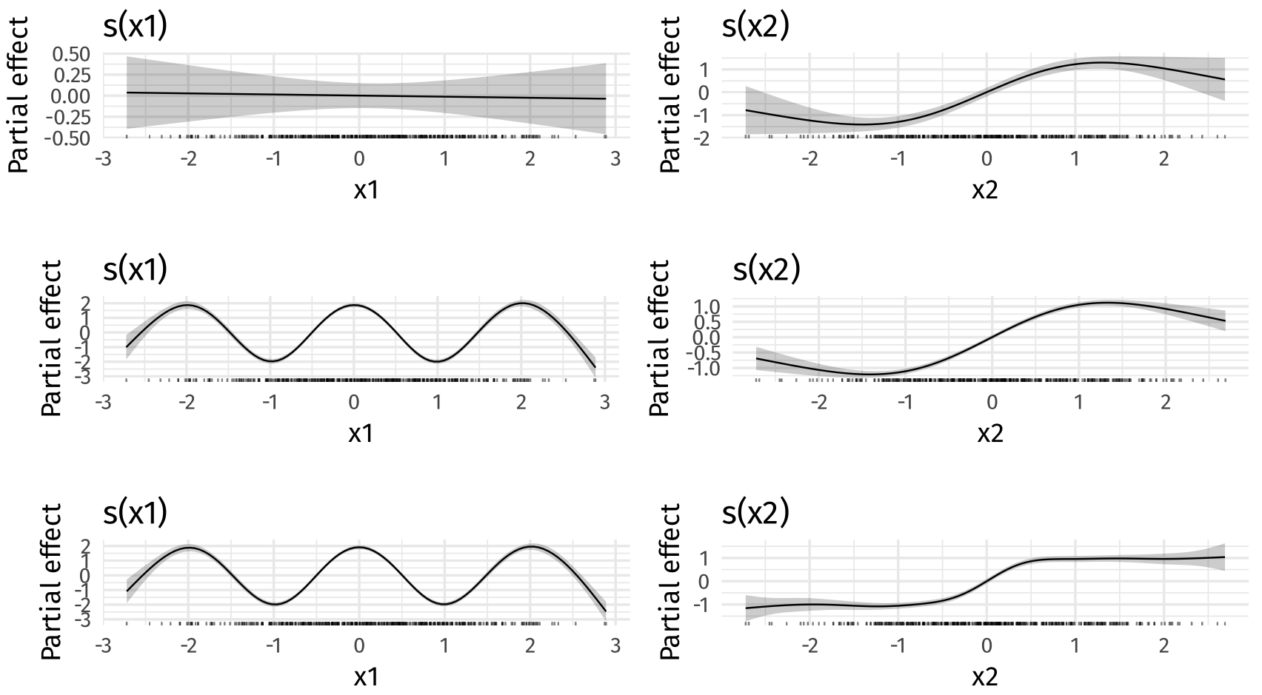
Right functional form ?
K=4
K=4
Explore how changes of the Maximum allowed wiggliness (k) determine the effect of the predictors.
s(x, k=10)
Vs
s(x, k=100)
K=12
K=4
K=12
K=12

Slide 44
GAMs Summary output How good is my smoothing
> gam.check(b)
Method: GCV Optimizer: magic
Smoothing parameter selection converged after 9 iterations.
The RMS GCV score gradient at convergence was 5.617993e-07 .
The Hessian was positive definite.
Model rank = 37 / 37
Basis dimension (k) checking results. Low p-value (k-index<1) may
indicate that k is too low, especially if edf is close to k'.
k' edf k-index p-value
s(x0) 9.00 2.47 1.04 0.77
s(x1) 9.00 3.31 1.01 0.54
s(x2) 9.00 8.11 0.97 0.31
s(x3) 9.00 1.63 1.11 0.99
Amount of smoothing
linear (1)…non-linear(8-10>)
Are the model residuals random?
small p-values indicate that residuals are not randomly distributed.
Significance here means you have the right dimension of the basis

Slide 45
p values for smooths
They are a test of a zero-effect of a smooth term.
But the critical point is that p values for smooths are approximate:
They don't account for the estimation of λ_{j} – treated as known, hence p values are biased low
Relay on asymptotic behaviour — they tend towards being right as the sample size tends to ∞

Slide 46
GAMs Summary output p-values
Significance parametric terms
> summary(M4)
Family: gaussian
Link function: identity
Formula:
So ~ s(De) + fID
Parametric coefficients:
Estimate Std. Error t value Pr(>|t|)
(Intercept) 19.198 1.054 18.207 < 2e-16 ***
fID13 -12.296 1.397 -8.801 7.59e-13 ***
---
Signif. codes: 0 ‘***’ 0.001 ‘**’ 0.01 ‘*’ 0.05 ‘.’ 0.1 ‘ ’ 1
Approximate significance of smooth terms:
edf Ref.df F p-value
s(De) 4.849 5.904 14.77 7.08e-12 ***
---
Signif. codes: 0 ‘***’ 0.001 ‘**’ 0.01 ‘*’ 0.05 ‘.’ 0.1 ‘ ’ 1
R-sq.(adj) = 0.695 Deviance explained = 71.9%
GCV = 38.802 Scale est. = 35.259 n = 75
Significance smoothing term

Slide 47
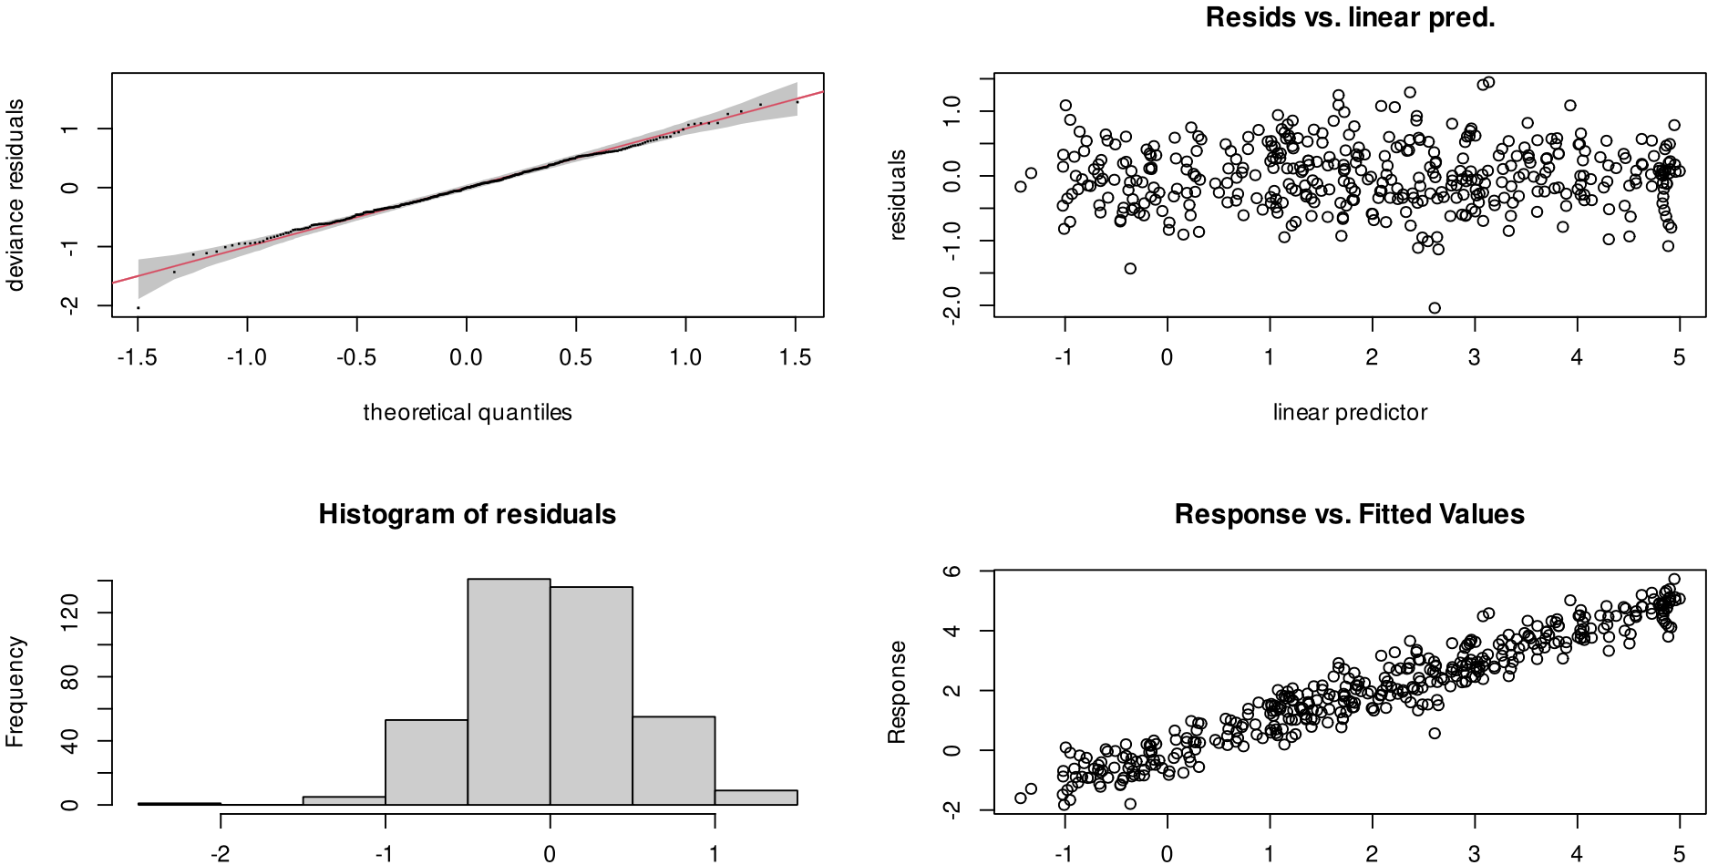
Diagnostic plots

Slide 48
GAMs Summary output How good is my model
> summary(M4)
Family: gaussian
Link function: identity
Formula:
So ~ s(De) + fID
Parametric coefficients:
Estimate Std. Error t value Pr(>|t|)
(Intercept) 19.198 1.054 18.207 < 2e-16 ***
fID13 -12.296 1.397 -8.801 7.59e-13 ***
---
Signif. codes: 0 ‘***’ 0.001 ‘**’ 0.01 ‘*’ 0.05 ‘.’ 0.1 ‘ ’ 1
Approximate significance of smooth terms:
edf Ref.df F p-value
s(De) 4.849 5.904 14.77 7.08e-12 ***
---
Signif. codes: 0 ‘***’ 0.001 ‘**’ 0.01 ‘*’ 0.05 ‘.’ 0.1 ‘ ’ 1
R-sq.(adj) = 0.695 Deviance explained = 71.9%
GCV = 38.802 Scale est. = 35.259 n = 75
Explained deviance (R²)

Slide 49
GAMs Summary output How good is my model
> summary(M4)
Family: gaussian
Link function: identity
Formula:
So ~ s(De) + fID
Parametric coefficients:
Estimate Std. Error t value Pr(>|t|)
(Intercept) 19.198 1.054 18.207 < 2e-16 ***
fID13 -12.296 1.397 -8.801 7.59e-13 ***
---
Signif. codes: 0 ‘***’ 0.001 ‘**’ 0.01 ‘*’ 0.05 ‘.’ 0.1 ‘ ’ 1
Approximate significance of smooth terms:
edf Ref.df F p-value
s(De) 4.849 5.904 14.77 7.08e-12 ***
---
Signif. codes: 0 ‘***’ 0.001 ‘**’ 0.01 ‘*’ 0.05 ‘.’ 0.1 ‘ ’ 1
R-sq.(adj) = 0.695 Deviance explained = 71.9%
GCV = 38.802 Scale est. = 35.259 n = 75
Explained deviance (R²)

Slide 50
Concurvity
Is a preditor a smoothed function of all other predictors
Think of this a a Toletrance metric
> concurvity(b,full=TRUE)
para s(x0) s(x1) s(x2) s(x3)
worst 8.220171e-25 0.1775308 0.17171220 0.13176623 0.11661316
observed 8.220171e-25 0.1220149 0.08047866 0.05064313 0.04062785
estimate 8.220171e-25 0.1243112 0.09152190 0.04004836 0.04134264
Always loo at the worst case
If any value is above 0.8 there is an issue

Slide 51
Concurvity
Is a preditor a smoothed function of another predictor
Think of this as correlation testes
> concurvity(b,full=FALSE)
$worst
para s(x0) s(x1) s(x2) s(x3)
para 1.000000e+00 1.088686e-26 7.108965e-25 1.080608e-26 3.158109e-26
s(x0) 1.071690e-26 1.000000e+00 1.167958e-01 7.279796e-02 6.536876e-02
s(x1) 7.127312e-25 1.167958e-01 1.000000e+00 5.818683e-02 6.533586e-02
s(x2) 1.068637e-26 7.279796e-02 5.818683e-02 1.000000e+00 5.848944e-02
s(x3) 3.114202e-26 6.536876e-02 6.533586e-02 5.848944e-02 1.000000e+00
$observed
...
$estimate
...
If any value is above 0.8 there is an issue
Always loo at the worst case

Slide 52
So far so good?
Any questions?
Ready to continue?

Slide 53
Model selection
We aim for a balance between fit and parsimony.
​In applied research, we seek the set of covariates with the strongest effects on the response variable.
But we also…
Seek a subset of covariates that improves interpretability and prediction accuracy.

Slide 54
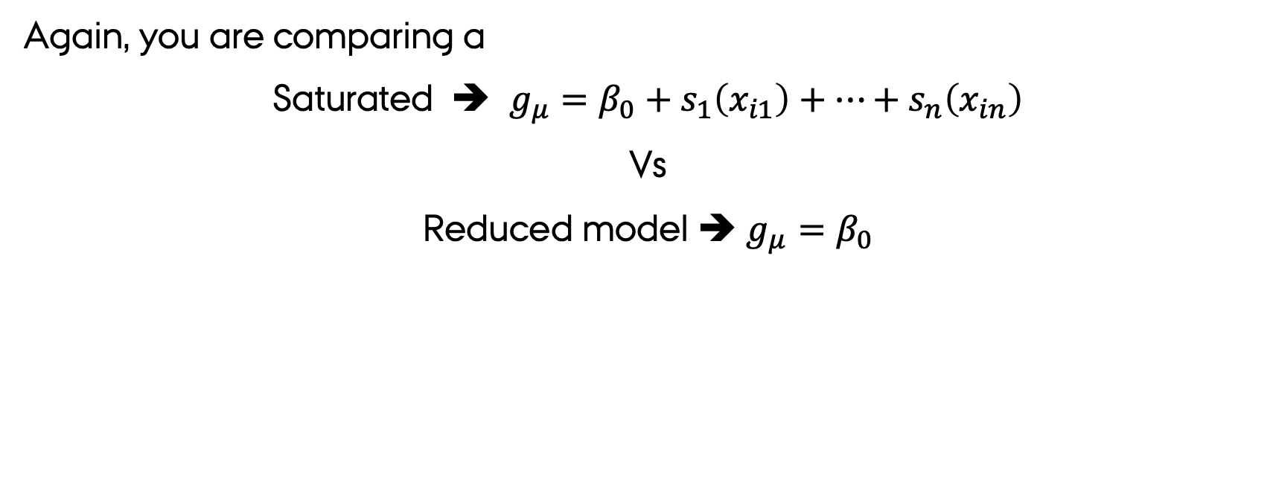
It all boils down to testing changes in deviance
Again, you are comparing a
Saturated ➔ $g_{μ}=β_{0}+s_{1}\left(x_{i1}\right)+…+s_{n}\left(x_{in}\right)$
Vs
Reduced model ➔ $g_{μ}=β_{0}$
You are testing for a significant change in the deviance of the model
using a log-likelihood ratio test

Slide 55
So far so good?
Any questions?
Ready to continue?

Slide 56
Expanding GAMs – Beyond the Gaussian models
​You can use GAMS to model processes related to traditional GLMM families
Poisson
Gamma
Gaussian
Binomial
Why?
GAMS are fancy GLMM → So you need to adjust for the “family” type when specifying your model

Slide 57
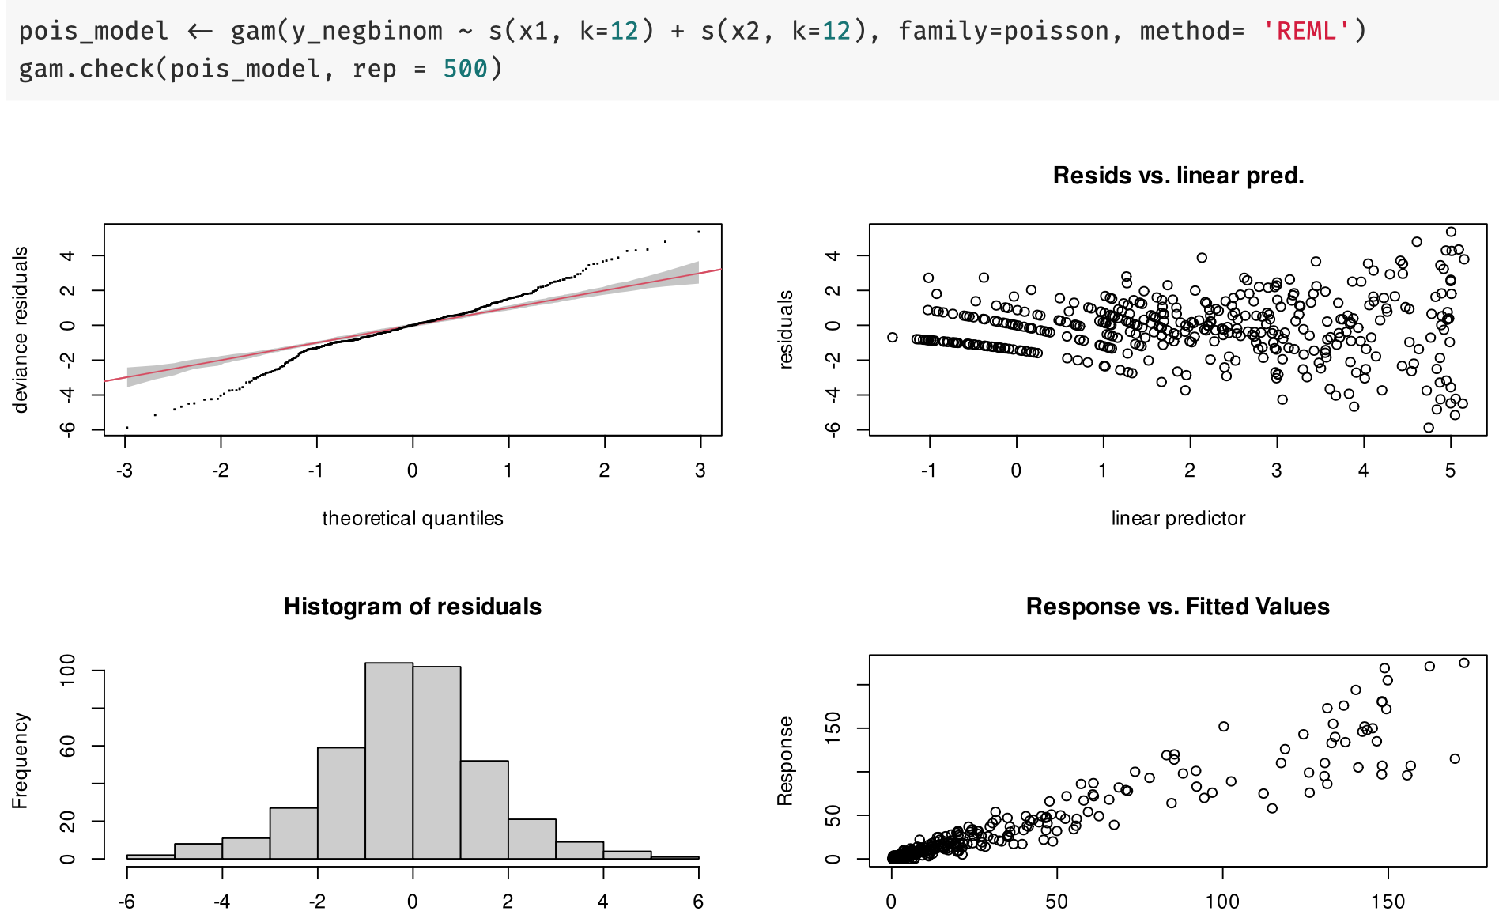
Thanks Gavin Simpson
https://gavinsimpson.github.io

Slide 58
Expanding GAMs – Beyond the Gaussian models
GAMS have expanded to other ”families”
Negative binomial
Zero-inflated
Multivariate normal data
Ordered and unordered categorical data

Slide 59
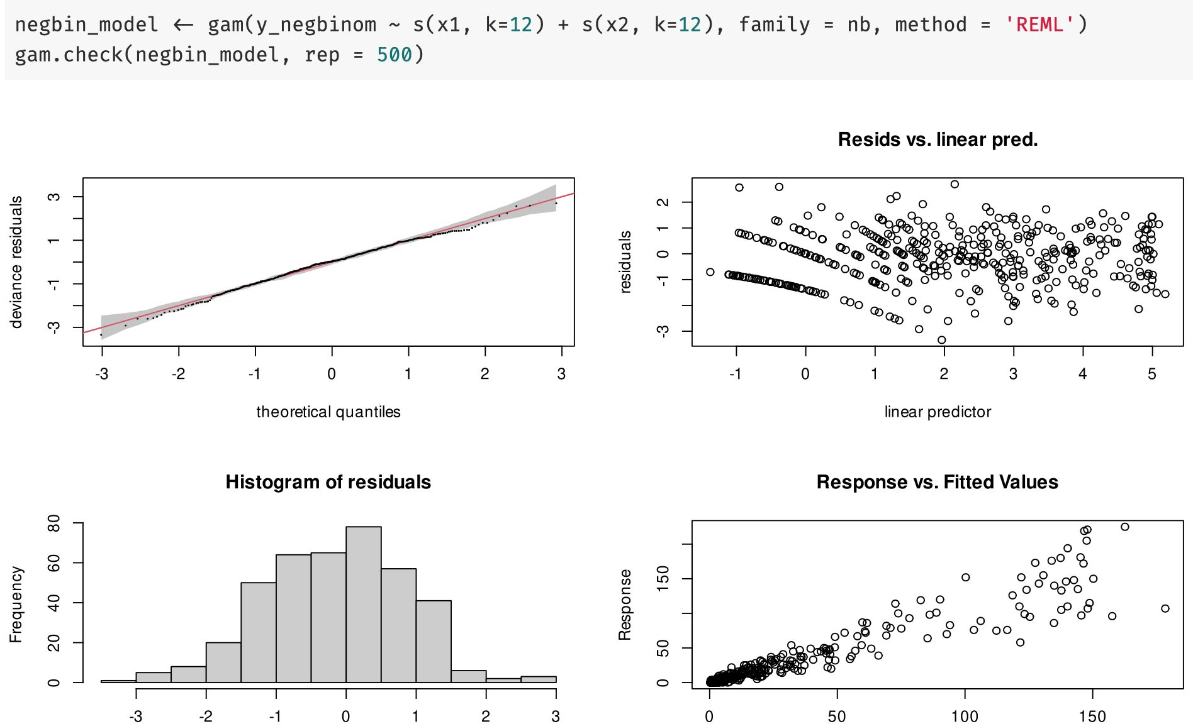
Thanks Gavin Simpson
https://gavinsimpson.github.io

Slide 60
So far so good?
Any questions?
Ready to finish?

Slide 61
In summary…
When the linear-parametric way can not find a good-fit we should use alternative regression approaches
An alternative to polynomial regression approaches is:
General Additive Models: GAM.
GAMs:
Are GLMMs plus some extra wiggles.
Allow to model Non-linearity in the data easily Via the use of spline functions → GAM
Extend the range of application of generalised linear models (glm)

